Slide 1
Group F4: Semmtech End-of-Prototyping
Xiaotian Chen, Florian de Graaf, Zsófia Katona, Dimitrios Papadopoulos
15 December 2023

Slide 2
Recap
Started from the test taxonomy provided
Transformed into Turtle Language
Created Basic relationships of activities with sectors and naces
Linked Nace vocabulary
Focus on Construction Sector

Slide 3
Current state of research
Researched DeBERTa model for fully automatic extraction
→ Performance of such methods appears to be insufficient → full automation is not feasible for the project
“Manual” ontology construction methodologies (METHONTOLOGY)
→ Combine these with NLP approaches to extract information from free text as well
Notes:
FULL AUTOMATION:
We initially aimed to achieve automatic extraction of key information by utilizing the DeBERTa model. However, the results obtained after processing the sample texts were far from satisfactory. Therefore, we discovered that achieving complete automation in both extracting and processing information is incredibly challenging.
MORE MANUAL METHODS:
We looked into methodologies for ontology construction that rely on human knowledge engineering. While many of these are mostly guidelines with a lot of freedom for the specific problem, the general steps and approach is documented clearly in some (mainly METHONTOLOGY in our search). Therefore, we believe we could use such a framework as a basis for building our ontology and enhance it through insight we gain from NLP on the parts of the taxonomy which are given in free text.

Slide 4
Visualization of our proposed pipeline
Ontology (Turtle)
Platform (unknown)
Input file (Excel)
Convert file to .ttl
Manually convert data into ontology
Export ontology
Upload & browse ontology to platform
Manual
Inspect data, understand the structure
Export free text
Add extracted concepts to nodes
Text converter (Python)
Automatic
Convert free text to key concepts with NLP
EDA
Processing / ontology creation
Evaluation
Notes:
3 steps: EDA, Processing, Evaluation
Fully automatic might lead to errors: manual + automatic part = semi-automatic construction

Slide 5
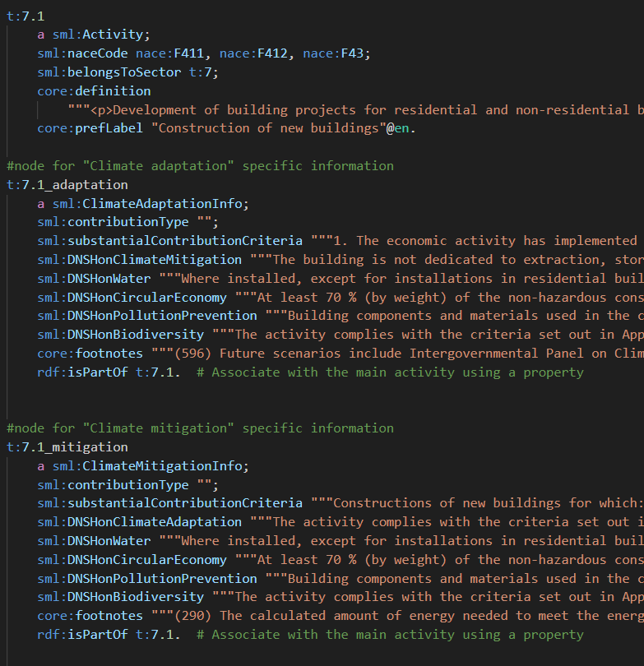
Activity example in Turtle

Slide 6
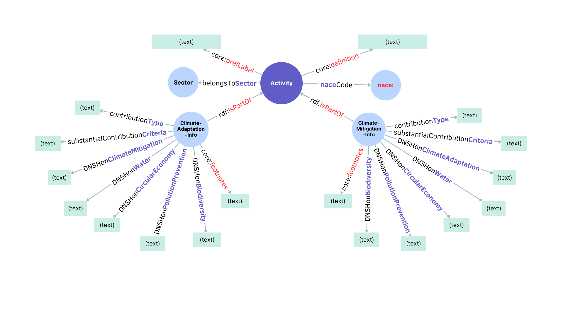
Ontology Schema

Slide 7
Text exploration (EDA) in Python
Goals: Finding concepts to include in the ontology and explore additional insight which could be gleaned from the free text
Notes:
As you can see, a lot of information in the ontology in its current state is in free text.
We have started implementing NLP methods in Python to explore this free text with two purposes:
Identifying key concepts to include as nodes and predicates in the ontology
Explore any additional insight that could be extracted from free text and used to enhance our model of the taxonomy

Slide 8
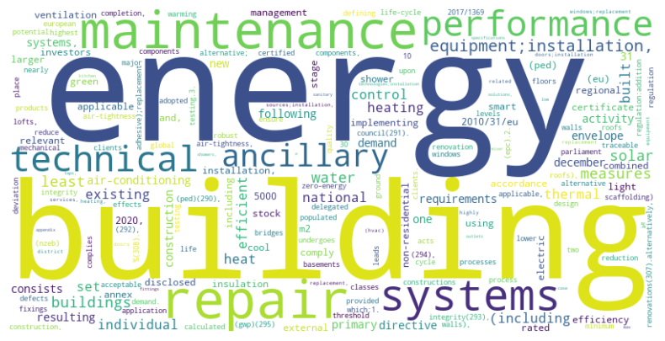
Finding key words and concepts
Notes:
We started out by identifying keywords in the free text cells of the construction sector.
This in itself does not say much, so we dived deeper.

Slide 9
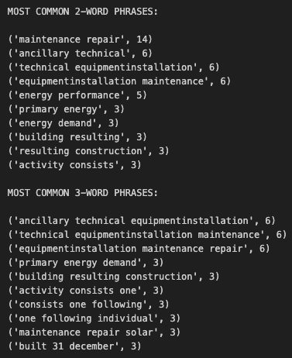
Finding most common phrases
Identifying key concepts to include in ontology
Identifying repeating patterns that carry additional insight about criteria
Notes:
We identified the most frequent longer phrases in the text.
In search of key concepts to include in the ontology
And to find repeating patterns that carry additional insight (e.g., what sub-activities the criteria refer to, such as “maintenance and repair”, only buildings built before a certain date, etc.)

Slide 10
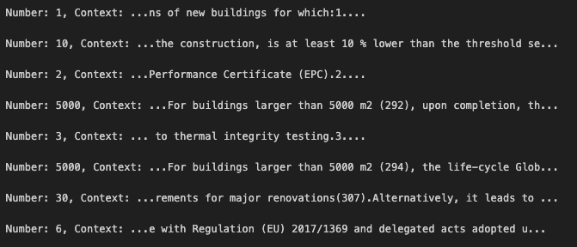
Finding numerical information in context
Notes:
We explored the numerical information contained in the free text.
References - regulations, footnotes, etc.
Limiting criteria - buildings larger than 5000 m2…
Numerical criteria (“at least 10% lower than…”)

Slide 11
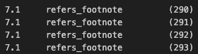

Demo of adding insight from free text
Footnote references
→ Identifying footnotes by matching text patterns
→ Similarly with Appendices, EU regulations, etc.
Regulation limitations
→ Identifying limiting criteria to the applicability of requirements
→ Might be possible to find the specific requirements which apply only to a subset of cases
Notes:
Examples of how the ontology can be enhanced - automatic generation of triples:
Footnote references
Regulation limitations - when criteria only apply to sub-cases of an activity
Possible to find limitations AND the requirements which these limitations apply to

Slide 12
Ontology Schema

Slide 13
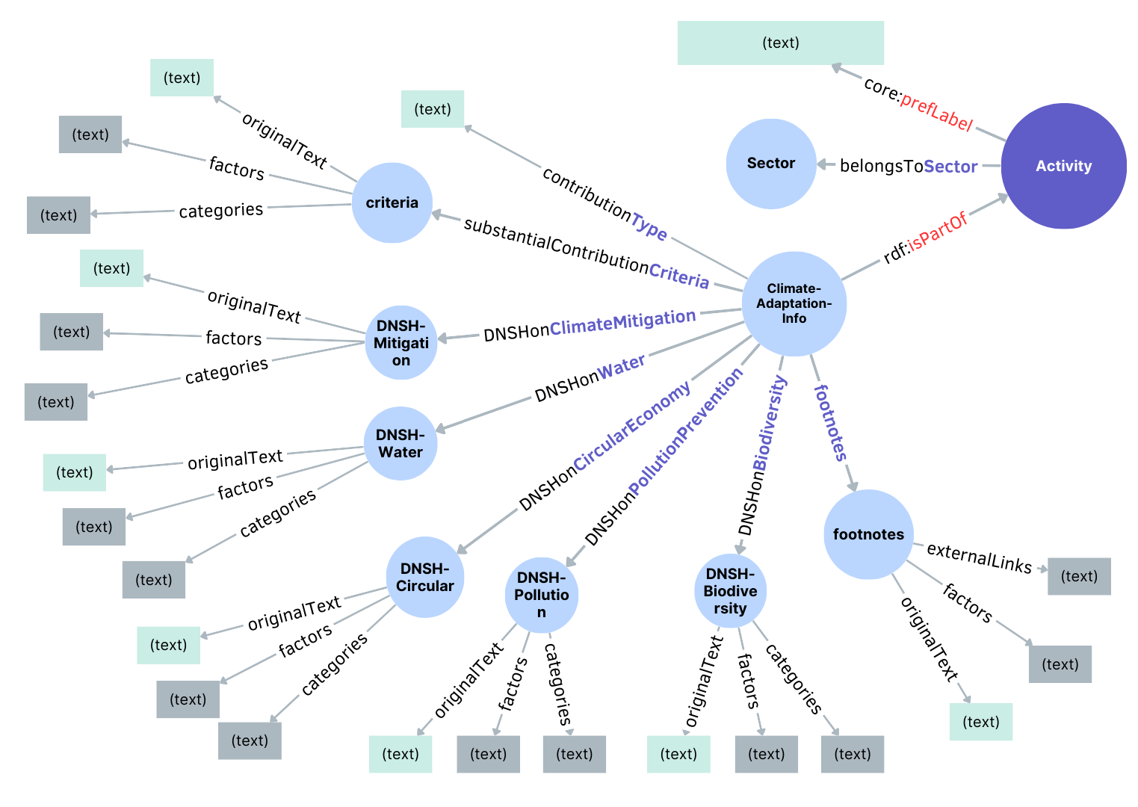
Possible extension of Ontology

Slide 14
Our next step
Going forward - challenges, etc.:
Automatic method of generating potential datalinks:
After spending some time researching and reviewing literature, we've discovered that a knowledge graph serves as a promising machine learning algorithm for generating potential datalinks.
The original knowledge graph model is too simple for the project to generate the the datalink. Therefore, we need to model some other optimized models to train our data and generate knowledge graphs.
Deciding on the exact evaluation method:
Possibilities: automatic tools, methodologies, interview with someone in the field.
Notes:
Basic knowledge graph models tokenize text and generate interlinked descriptions, but this approach doesn't fully meet our needs. Therefore, we need to optimize the way knowledge graphs extract key information. Currently, various AI industry-related companies like IBM, Google, among others, are continuously refining the knowledge graph model. Hence, we might explore utilizing pretrained models to achieve our objectives.

Slide 15
Questions?

